Slide 1
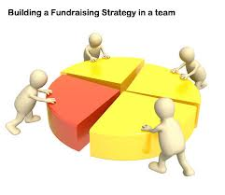


Slide 2
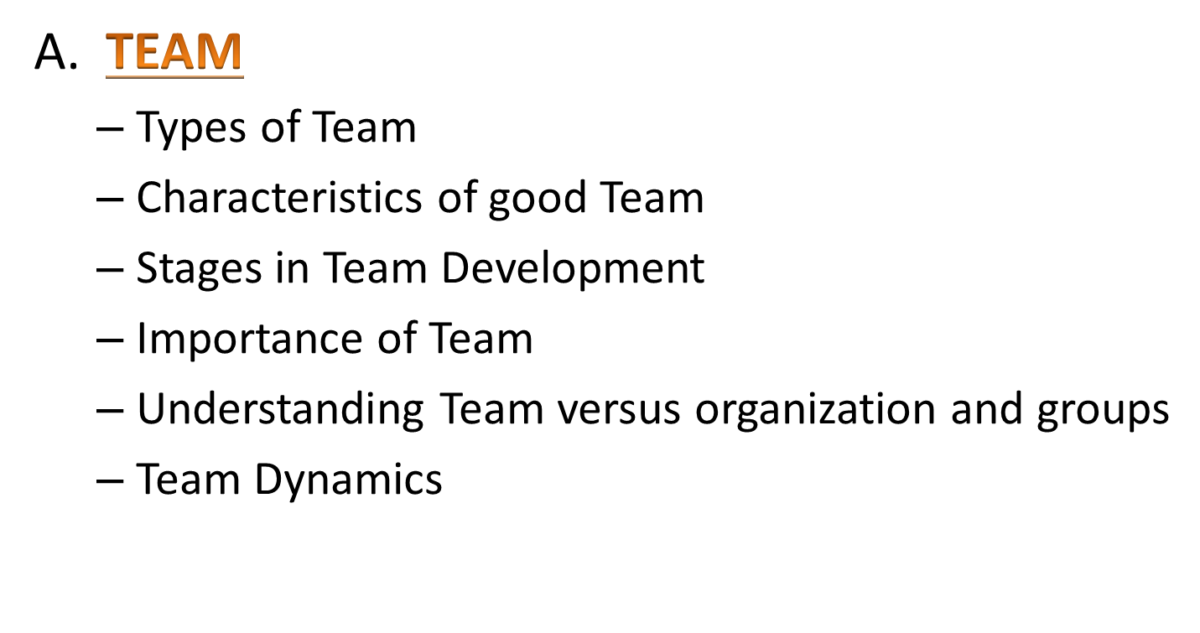
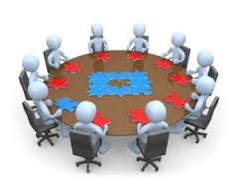
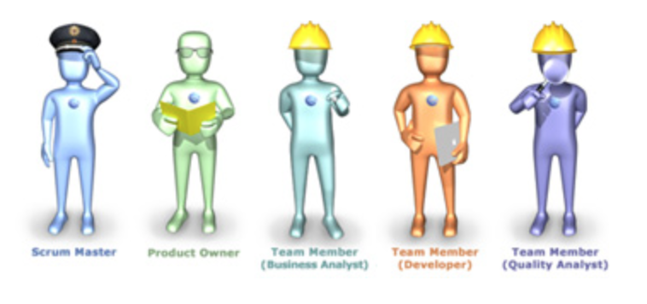
Content of this lecture:

Slide 3
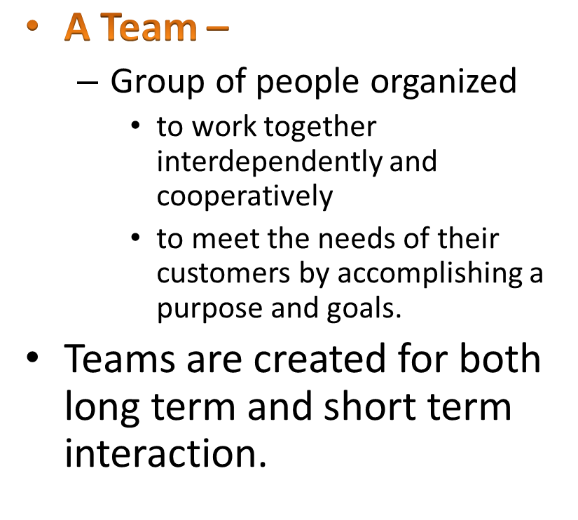
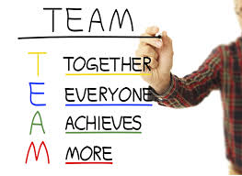
TEAM

Slide 4

Everyone participates actively and positively in meetings and projects
Team goals are understood by everyone
Individual members have thought hard about creative solutions to the problem.
Members are carefully listened to and receive thoughtful feedback.
Everyone takes initiative to get things done.
Each teammate trusts the judgment of others.
The team is willing to take risks.

Slide 5

There is a plenty of communication between team members
Team goals are given realistic time frames
Everyone is focussed on the ultimate goal of the project while also digging into the underlying details
Team decisions are made using organized and logical methods
Full team acceptance is expected as decisions are made
Everyone is supportive of the project and of the others

Slide 6

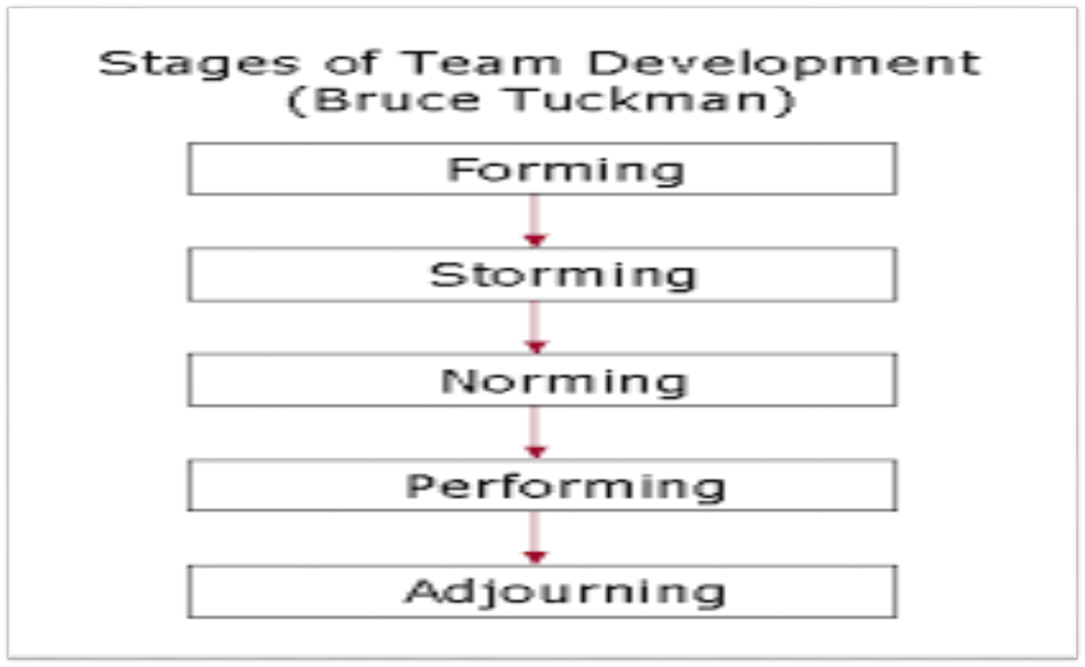

Slide 7
FORMING
Usually characterized by some confusion and uncertainty(because roles are not cleared)
The major goals of the group have not been established
The nature of the task or leadership of the group has not been determined
Thus forming is an orientation period(members get to know about one another and share expectations about the group)
Members learn the purpose of the group as well as rules to be allowed

Slide 8
STORMING
The group is likely to see the highest level of disagreement and conflict
Fight for leadership position
This can be a positive experience for all the groups if members can achieve cohesiveness (organized and unified)through resolution.

Slide 9
NORMING
Established RULES OF ENGAGEMENT
The scope of groups task is clear and agreed
Individual listen to each other,appreciate and support each other and are prepared to change pre conceived views.
They feel that the are part of team
At this stage team members will begin and develop close relationships and a feeing of group cohesion
Cooperative effort should begin to yield results
Responsibilities are divided
Progress is evaluated

Slide 10
PERFORMING
Not all the groups reach this stage,characterized by the state of interdependance and flexibilty
Everyone knows each other well enough
Trust enough
Roles and responsibility change accordingly to the need
Group identity,loyality and morale are high.
Members make decisions through rational process i.e focussed on relevant goals rather than emotional issues

Slide 11
ADJOURNING
Not all group experience this stage because it is characterized by the disbandment(dissolve) of the group
Some groups are permanent
Reasons that groups disband vary with common reasons being the accomplishment of the task
They need to recognise what they have done
It is also known as DEFORMING and MOURNING
Because of recognizing the sense of loss felt by group members

Slide 12
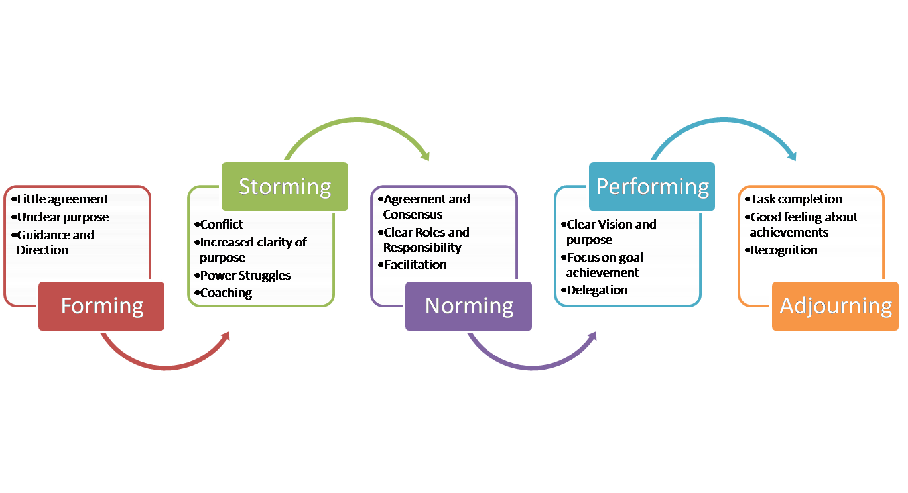

Slide 13
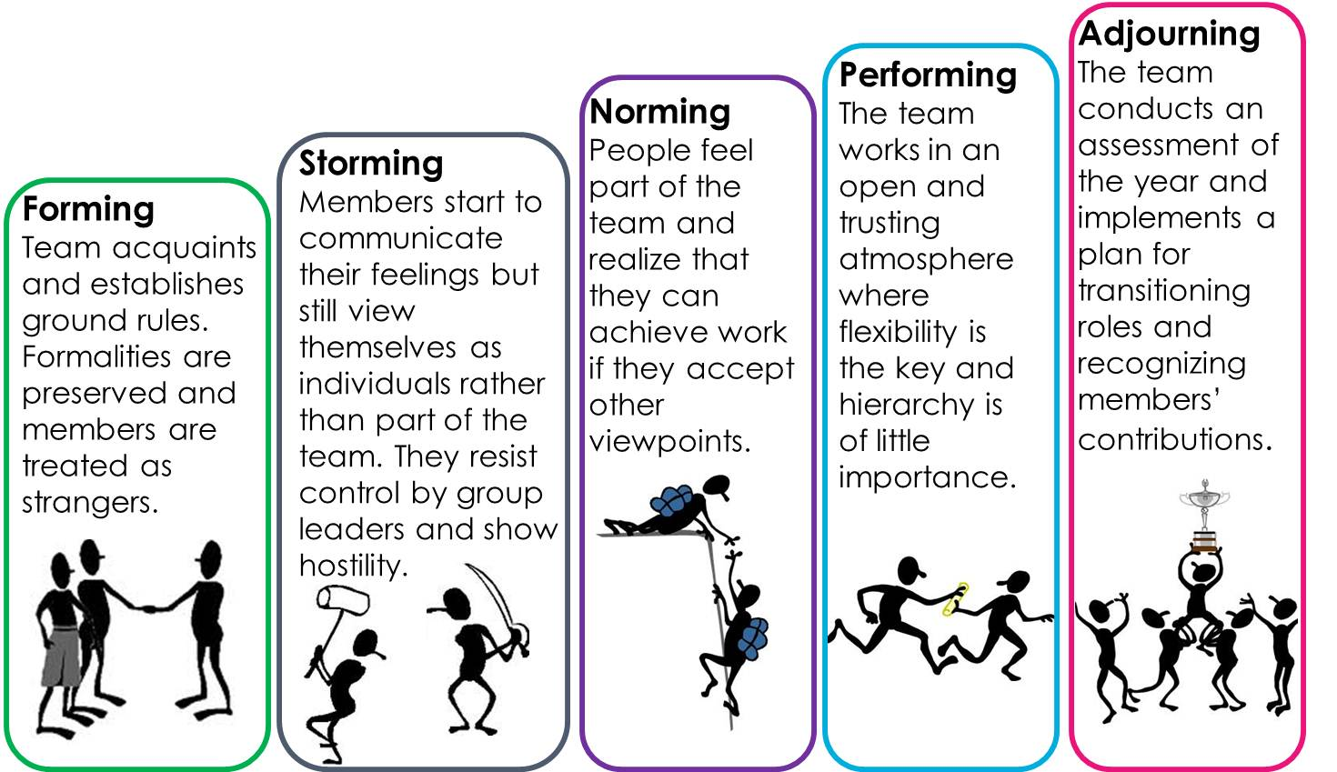


Slide 14

No organization runs for charity
Tasks are accomplished at a faster place
Work never suffers or takes a backseat in team
Healthy competition among team members.
Improve Relationships
Team members can also gain from each other

Slide 15

Organization | Group | Team
Too large and impersonal | Small and may impact members feelings and self-image | Small and members have a stronger sense of identification
Little inter-member interaction and reciprocal influence | Important psychological methods(e.g social contact) are better satisfied. | Greater task interdependence
 | Members can contribute to goal accomplishment by working independently | Members have more differentiated and specialized roles.
 | Members play a variety of roles | Members often play a single or primary role

Slide 16

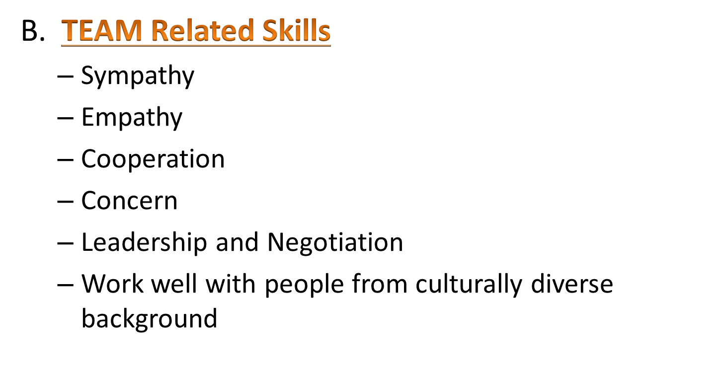
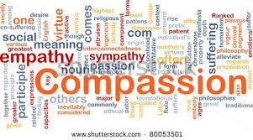

Slide 17

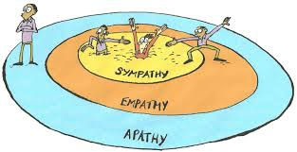
Sympathy is a social affinity in which one person stands with another person, closely understanding his or her feelings.
It also can mean being affected by feelings or emotions.
Thus the essence of sympathy is that one has a strong concern for the other person.

Slide 18

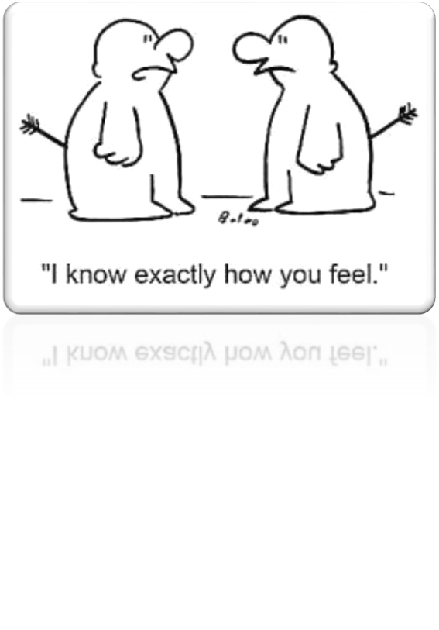
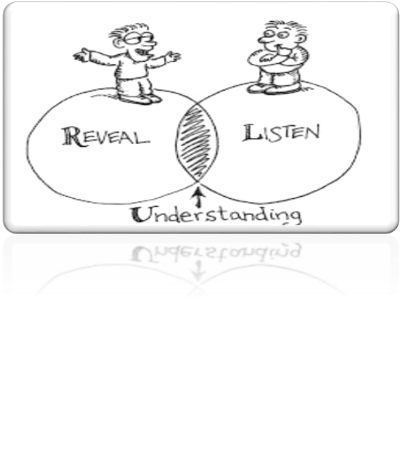
Empathy is the capability to share your feelings and understand another’s emotions and feelings. It is often characterized as the ability to “put oneself into another’s shoes,” or in some way experience what the other person is feeling.

Slide 19


Cooperation is "an act or instance of working or acting together for a common purpose or benefit."

Slide 20


Concern is a feeling of worry about something.
To be concerned for team members is to look out for their welfare and love them as you love yourself.
It contributes to high motivation and satisfaction at work

Slide 21

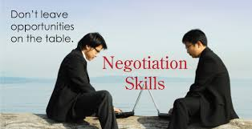
Leadership is an ability of a manager to induce subordinate to work with confidence and zeal.
Good Leaders are made not born.
Negotiation is compromise to settle an argument or issue to benefit ourselves.

Slide 22



Slide 23

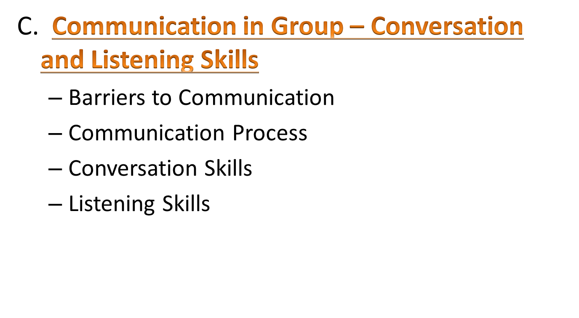

Slide 24

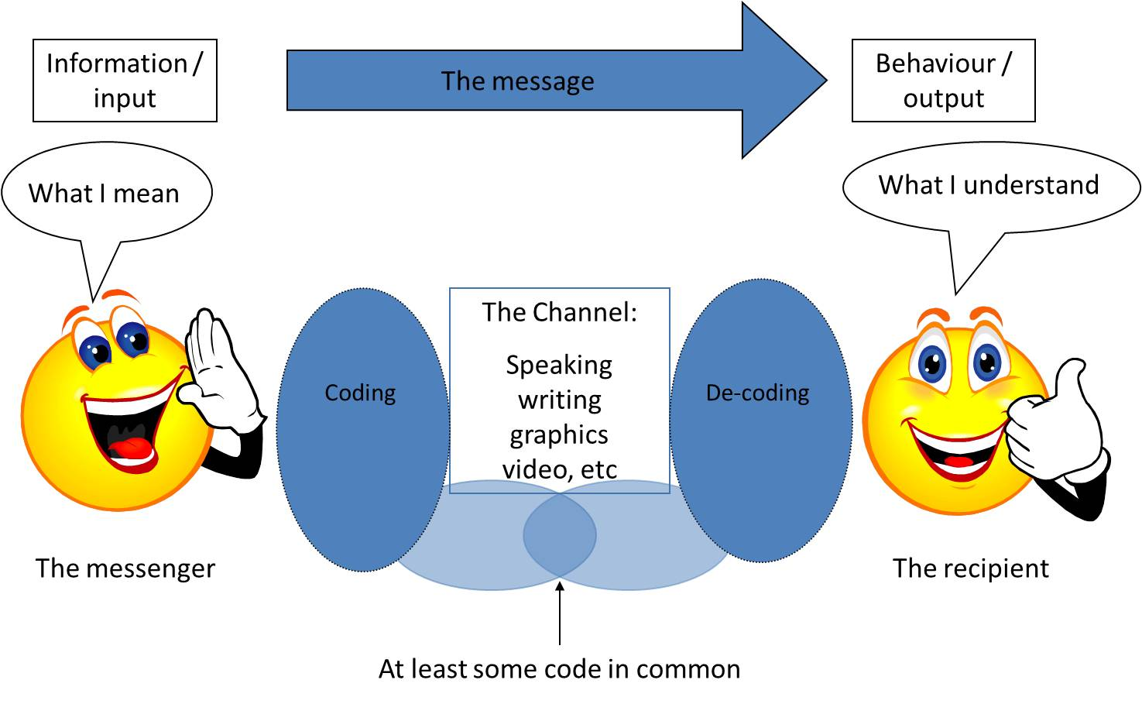
Communication is the exchange and flow of information and ideas from one person to another.
Effective Communication occurs only if the receiver understands the exact information or idea that the sender intended to transmit.

Slide 25
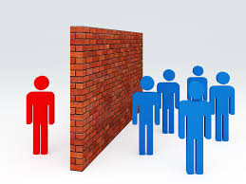

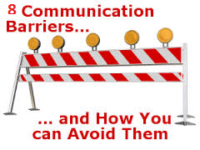
Perceptual and Language Differences
Information Overload
Inattention
Time Pressures
Distraction/Noise
Emotions
Complexity in Organizational Structure
Poor Retention

